Slide 1
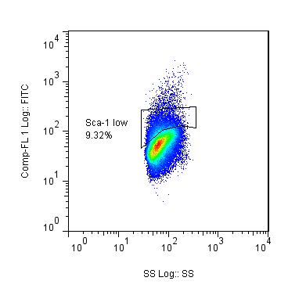
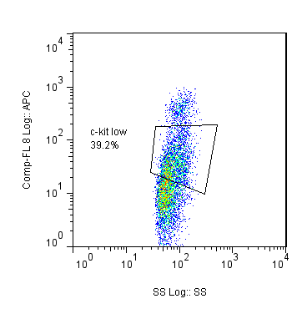
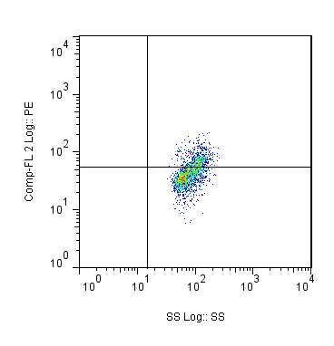
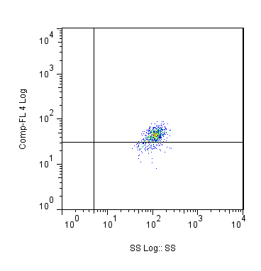
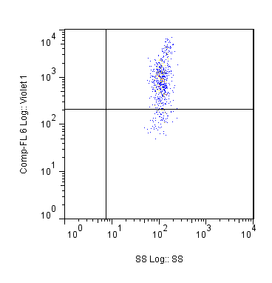
BLPs
Sca-1
C-kit
IL-7Rα
Flt3
Ly6D
ALPs
Side Scatter
Side Scatter
Side Scatter
Side Scatter
Side Scatter

